Slide 1

Rakan Alharbi
UK Incidents Data Analysis

Slide 2
Outline:
Introduction.
EDA.
machine learning algorithms.
Conclusion.

Slide 3
Introduction:
This project is an analysis of UK accident data from 2005 to 2015

Slide 4
EDA

Slide 5
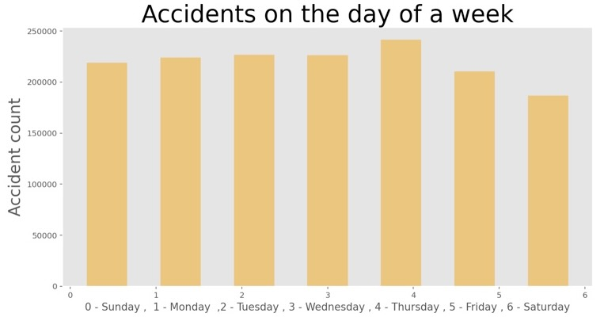
find out the number of accidents on the days of a week.

Slide 6
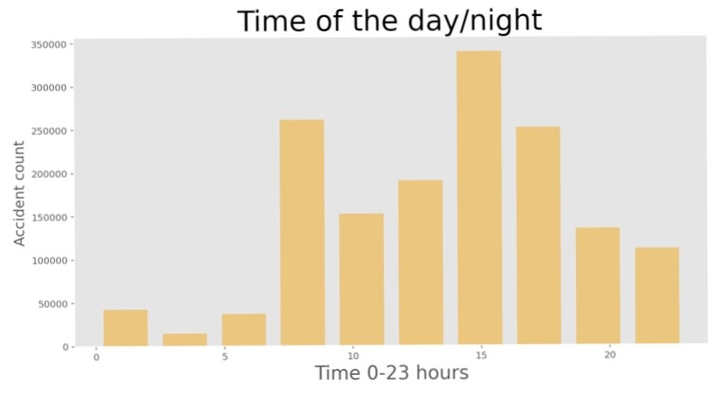
find out about the accidents number using hours of the day.

Slide 7
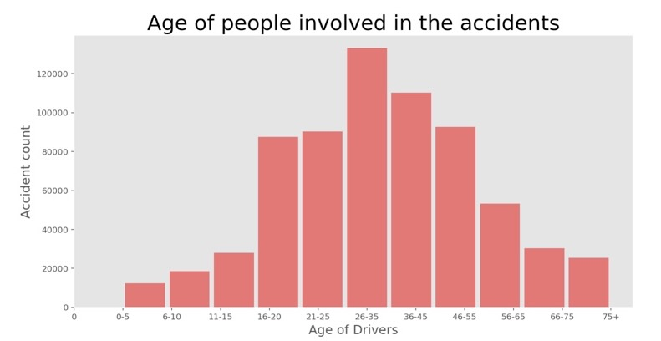
Finding out about the age of driver can tell us more about the accidents

Slide 8
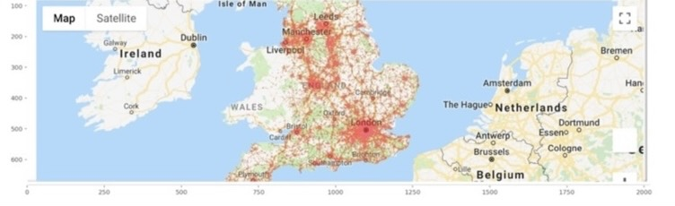
Plotting accidents Location on Google Maps:

Slide 9
machine learning algorithms.

Slide 10
data splitting:
Divide the data 80 percent of the training sample and 20 percent of the test sample

Slide 11

Machine learning: tuning the balance in data:

Slide 12
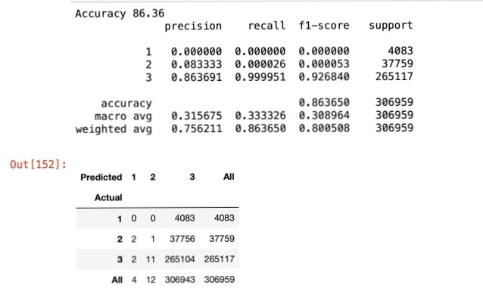
logistic regression algorithm:

Slide 13
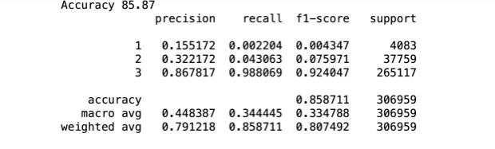
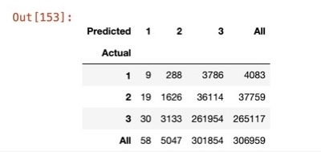
decision tree algorithm:

Slide 14
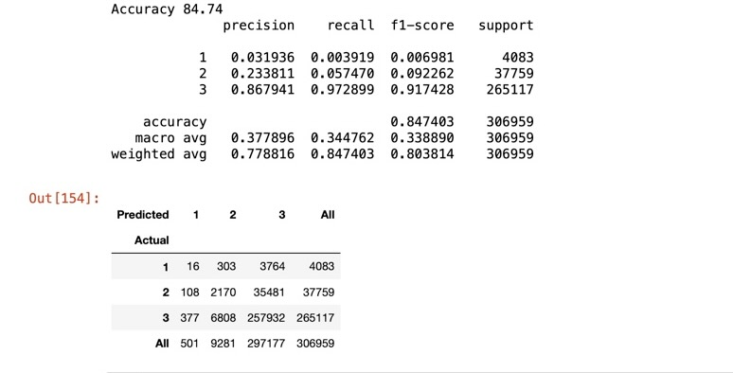
Random forest classifier algorithm:

Slide 15
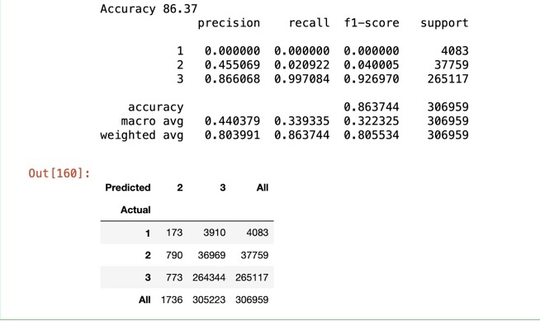
Grid search CV:

Slide 16
Conclusion:
Through my analysis of this data, it became clear to me that the best algorithm is Grid search CV: So that gave me the best confusion matrix and the best accurcy

Slide 17
Thank you

